Slide 1
Students Name
Characters Name: Wife of Bath

Slide 2
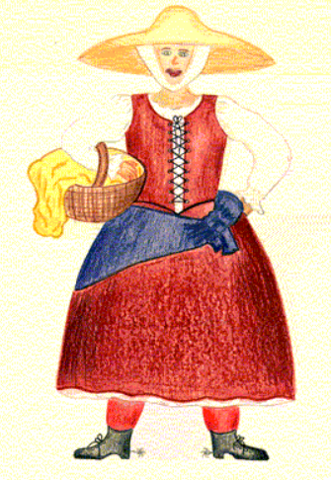
General Overview Of The Character
The Wife of Bath is a seamstress by occupation and a professional wife. The author further states that, “She is more interested in love than anything.”
Apart from having many affairs in her youth, she has been married at least five times, hence, making her an expert on love matters
She is presented as someone who loves sex and marriage but also takes pleasure in the rich attires, arguing and talking
She is deaf in one year and has a gap between her teeth.
The gaps are considered to be attractive physical features daring the Chaucer’s time
She has travelled across Europe and three times in Jerusalem.

Slide 3
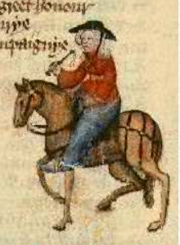
How The Character Reflects Medieval Culture
Women's role and identity in society during the medieval period were different from their role and identity in society now
The Wife of Bath is an outstanding woman who seems not to be a typical figure in the medieval times.
The character ignores authority, she defends her rights and even deconstructs the Christian doctrine.
Her body and beauty during the Medieval times was used to symbolize lust and sensuality.
She is a dedicated traveler, a medieval tourist that loves sight seeing. In the poem she travels through Europe and Jerusalem.

Slide 4
Qualities, Flows and Motivations of the Character
Qualities
The wife of bath is headstrong, bold and beautiful woman of her time
Her dressing symbolizes that she is not timid or shy
She is an expert weaver, which can be seen in her clothes
Motivations
She is motivated to establish the quest of women for self-definition.
Her experience in marriage motivates her to educate other women and men on healthy relationships
Flows
The main flow of the wife of Bath is going through five marriages unsuccessfully
She cannot accept defeat no matter what the cost. She feels that this is the way things should be and men should obey her.
This hunger for power can be seen when she says, “In wifehood wolf I use myn instrument as freely as my Makere hath it sent. If I be dangerous, God yive me sorwe: myn husbanded shall it han both eve and morwe when that him list come forth and pay his dette. An housbonde wol I have, I wol nat lette, which shal be bother my dettour and mt thral, and have his tribulacion withal upon his flesh whil that I am his wif”
She is also full of pride as she believes to be more powerful than the husbands, hence explaining the five failed marriages.

Slide 5
How does Chaucer (the author) feel about the character
In the beginning of the poem, the authors makes the wife of Bath stand out from all the other authors.
In Chaucer general prologue, the selected character is described in a manner that provokes response.
Chaucer keenly describes the characters physical features, clothes and reference to her past in a positive manner. Ideally, the descriptions fits one of a perfect Christian like woman.
Chaucer describes how she is talented as a weaver and devoted.
She states that, “Housbondes at chirche dore she hadde five” which means the character has been married two times.
Based on how the author has described the character, it appears she like holds a special liking and admiration for her.
She is a perfect portrayal of a wife and bold strong woman in the society.

